Slide 1


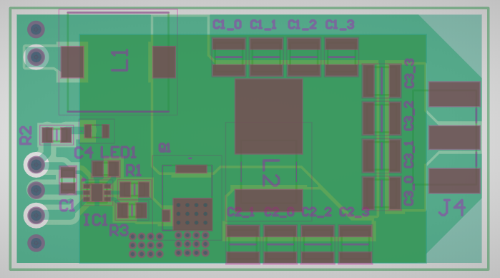
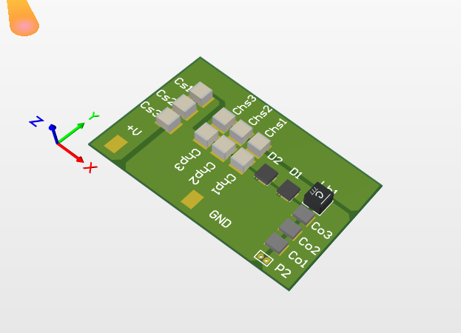
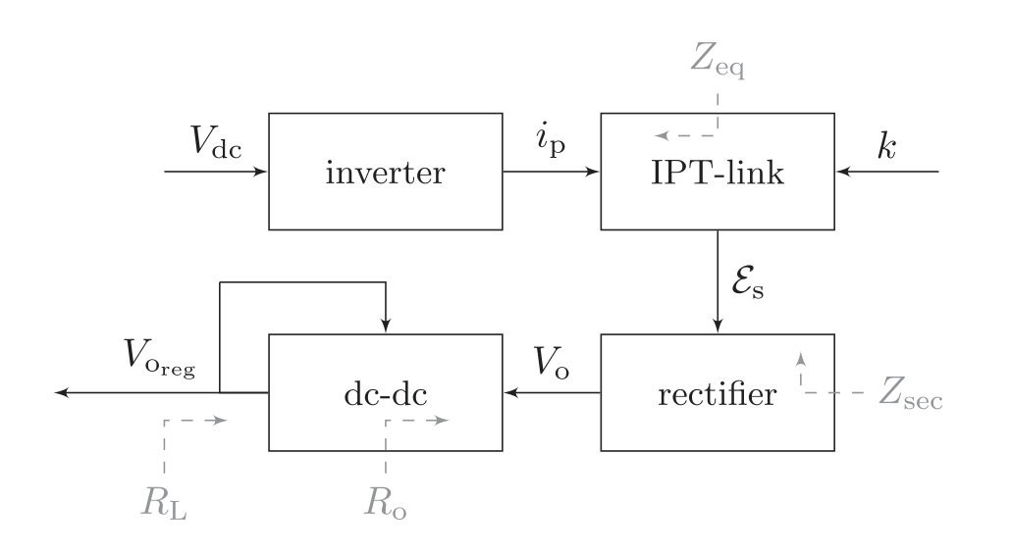
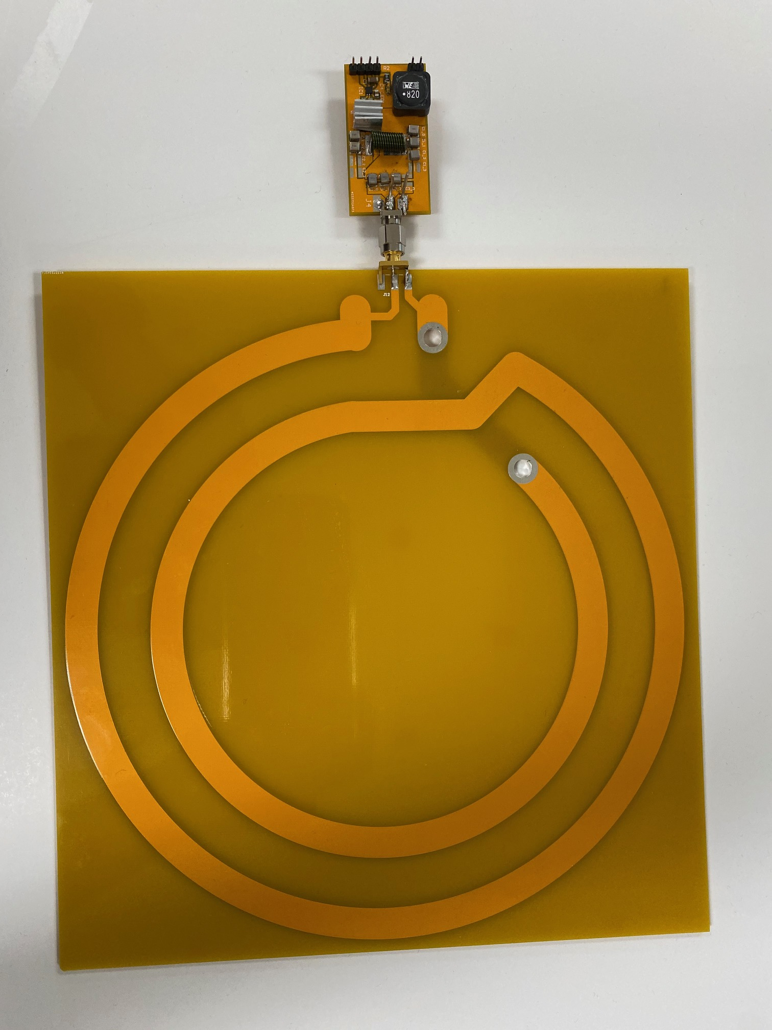
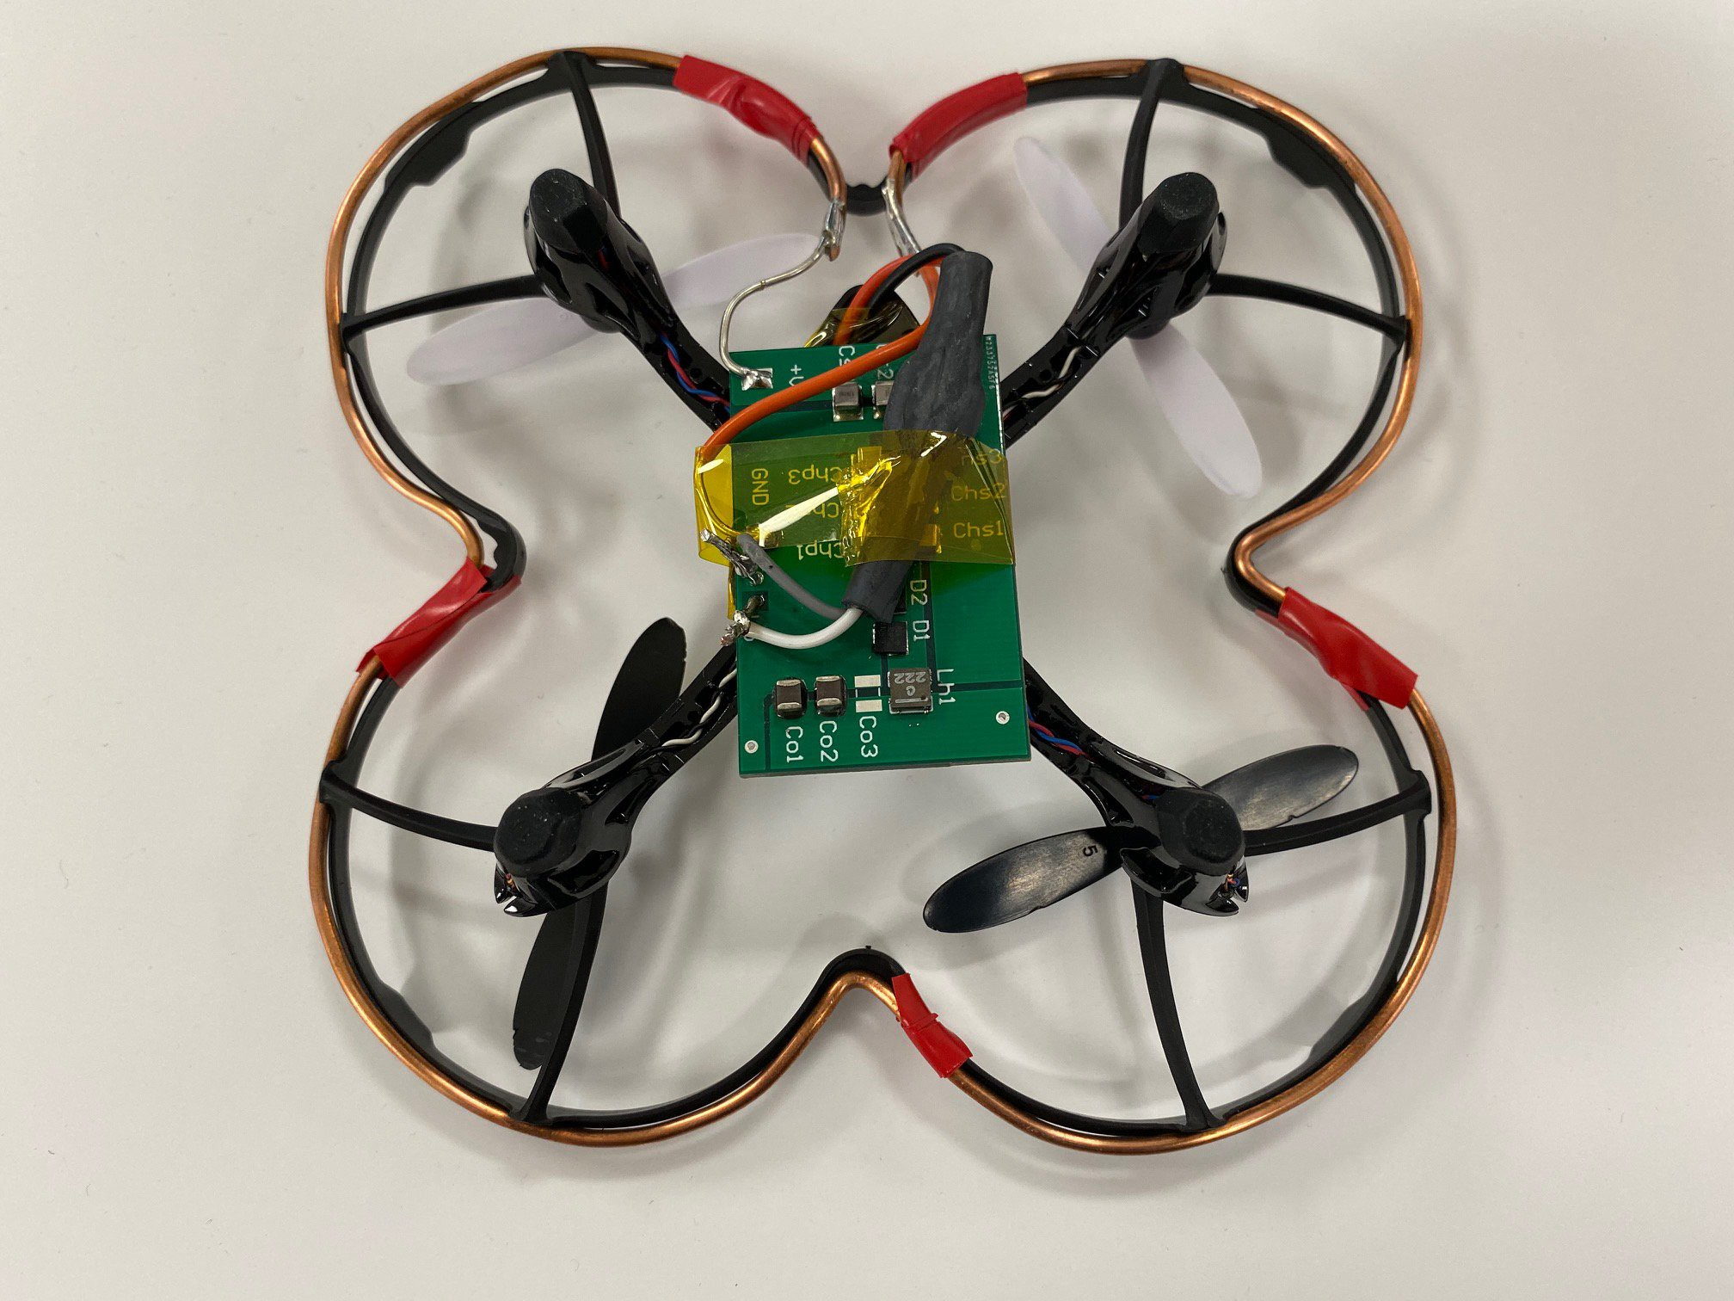
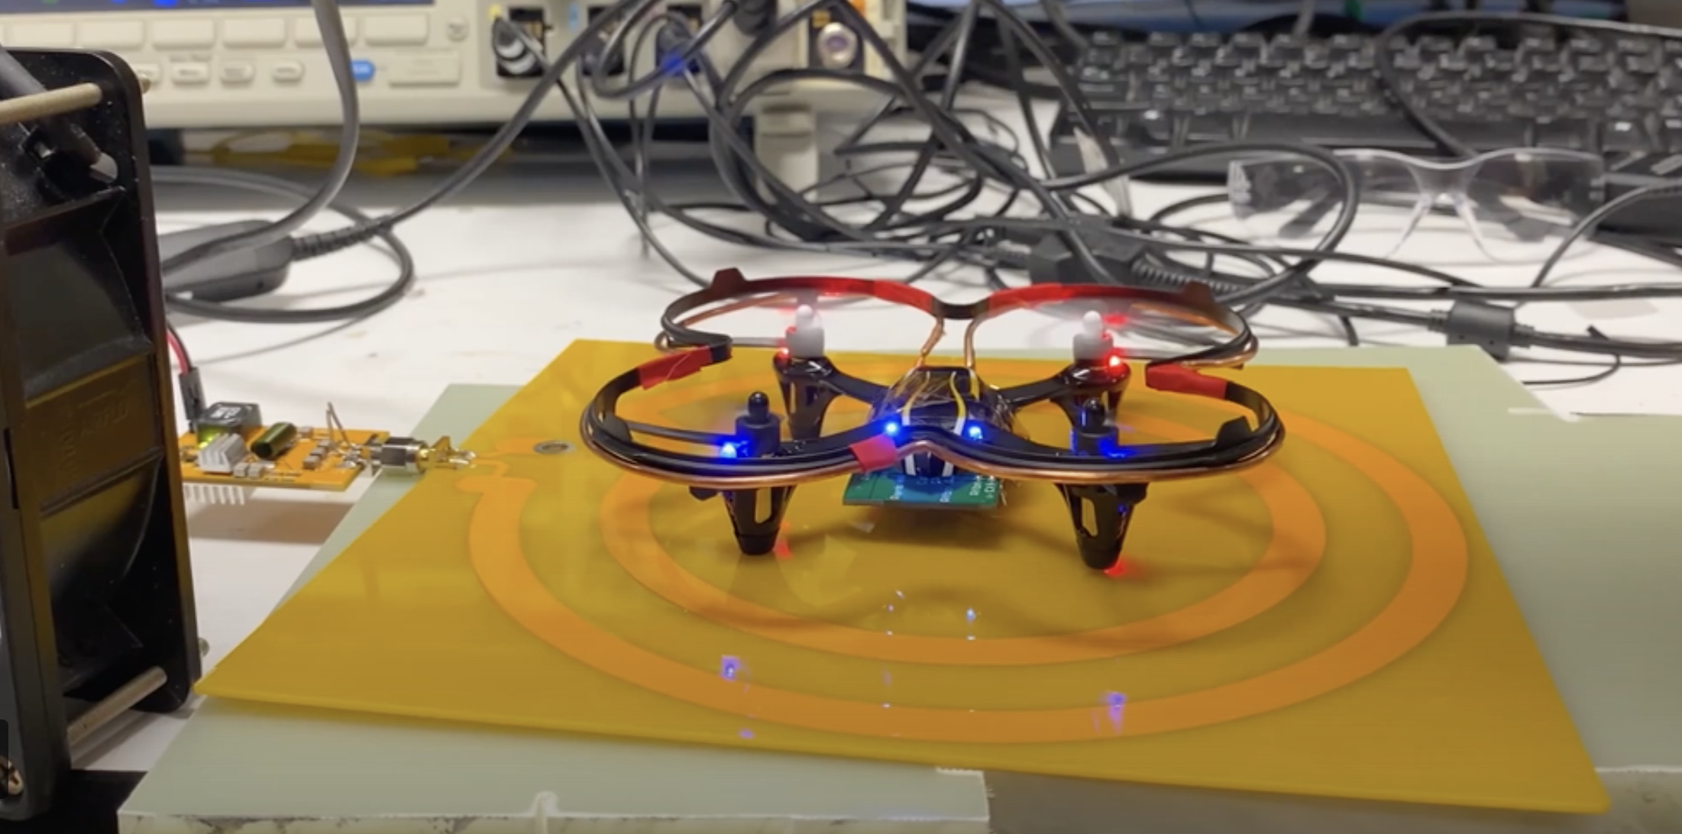

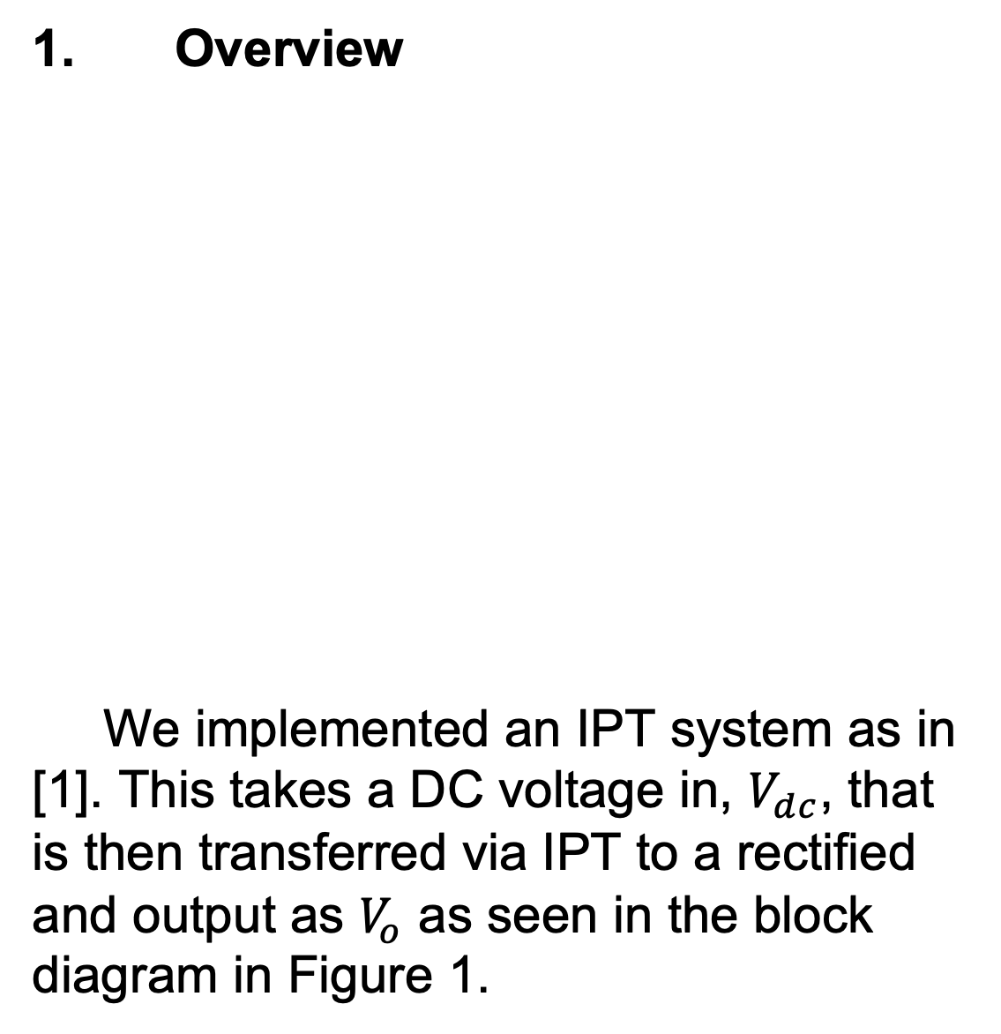
High-Frequency Wireless Power Transfer for In-Flight Drone Power
David Conner Borkowski, Isaac Tolbert, Olivia Richards, Alireza Dayerizadeh, Dr. Sdjran Lukic
Overview
Design Cont’d
Design Cont’d
Future Work
1. Background
Drones have become incredibly versatile in consumer, industrial, and military applications. This technology suffers from short flight times caused by heavy battery technology.
2. Problem Statement
Current technology for extending drone flight time lack power transfer range, scalability, an/or are not applicable to consumer quadcopters.
With Gallium Nitride transistor (GaNFET) technology, we designed a 13.56 MHz inductive power transfer (IPT) system that acted as a standalone power system for a small consumer drone.
2. Inverter
We built a Class EF inverter following the design in [1]. We did make modifications for heat dissipation and added a driver circuit for the GanFET.
3. Inductive Coils
The Inverter created a high frequency AC current that was fed to the IPT system. The coil on the side of the inverter followed the design in [1]. The coil on the rectifier was built to fit on the propeller guard of the drone. This was built with copper wire.
4. Rectifier
Connected to the coil on the drone is a Hybrid Class E rectifier that feeds a DC-DC voltage converter that powers the drone as in [1].
5. Simulations
This system, including the drone load was modeled in LTspice before building and voltages across the inductive coils were matched to results in [1].
Future work on this project should include redesigning the inverter board with better heat management and could include coupling multiple systems to increase drone fly area.
References
[1] J. M. Arteaga, S. Aldhaher, G. Kkelis, C. Kwan, D. C. Yates and P. D. Mitcheson, "Dynamic Capabilities of Multi-MHz Inductive Power Transfer Systems Demonstrated With Batteryless Drones," in IEEE Transactions on Power Electronics, vol. 34, no. 6, pp. 5093-5104, June 2019.
Figure 4. A rendering of the rectifier board that is mounted on the drone.
Figure 2. Rendering of the Inverter circuit with some heat management vias.
Design
Acknowledgements
Results
This project was supported by the Undergraduate Research Scholars Program hosted by The National Science Foundation, FREEDM Center, and PowerAmerica.
We thank Alireza Dayerizadeh, our mentor, for his aid and guidance.
Special thanks to Dr. Sdjran Lukic, our PI, for his support.
1. Overview
We implemented an IPT system as in [1]. This takes a DC voltage in, $V_{dc}$, that is then transferred via IPT to a rectified and output as $V_{o}$ as seen in the block diagram in Figure 1.
This design resulted in a drone that received power only from the IPT system. However, not enough power was transferred to sustain flight due to the GaNFET overheating.
Figure 1. Block diagram of IPT system with variable coupling, from [1].
A. B.
Partners
Figure 3. Pictures of A) printed circuit board inverter-side coil and B) the rectifier side coil mounted on the drone.
Figure 5. Drone powered, lights on and propellers rotating but not achieving enough lift to take off.

